Slide 1
Sachetan: A crowd-source based
personal safety application
Presented by,
Md. Ozayer Islam
Reg. No: 2013331062
Shadman Habib
Reg No: 2013331062
Supervised by
Sheikh Nabil Mohammad
Assistant Professor, Department of CSE
Shahjalal University of Science & Technology

Slide 2
Overview
Introduction
Literature Review
Previous Works
About the App
Methodology
Future Work

Slide 3
Introduction
Crime: A problem with no genuine solution
Murder
Mugging
Road-accident
Robbery
Sexual harassment
Theft

Slide 4
Literature Review
Two Types of Works in our Research:
Data Collection: Crowd Sourcing
Data Analysis

Slide 5
Data Collection
Among Many Apps that we reviewed Regarding Collecting the data from User ,
Following are some examples:
Safestreet
Protibadi
Hollaback
Safetipin
OnWatch

Slide 6
Some Features About those apps:
Safestreet app also runs in background in order to capture sexual harassments publicly.
“Protibadi” app has its own web interface and Mobile SMS system integrated with the database, enable the app to collect more data

Slide 7
Problems With the existing apps:
The apps are not generalized for all types of crimes.
Apps are used for collecting data and visualizing only, no real data analysis on them

Slide 8
Data Analysis:
Data mining in crime is quite a new topic in our country and also in the sub continent
Read the articles that are based in realistic data.
Very few papers available: Pioneering work

Slide 9
Paper Review :
In 2014, a paper named “Crime Analysis and Prediction Using Data Mining” by Shiju Sathyadevan, Devan M.S, Surya Gangadharan. S was published.
They completed their research in 5 steps:
1) Data Collection
2) Classification
3) Pattern Identification
4) Prediction
5) Visualization

Slide 10
Paper Review (Continued)
Data collected from different website, blogs, rss feeds, online newspapers.
For Keyword Extraction, NER (Named Entity Recognition)
Used Co-relation Resolution to determine relation between words
For Classifying, they used Naïve-Bayes.
For pattern Identification, They used Apriori algorithm.
For prediction, They used Decision tree.
Visualized using heat map

Slide 11
Paper Review : (Continued)
“Using Data Mining Technique to Analyze Crime of Bangladesh”
by Md. Abdul Awal, Jakaria Rabbi and Imran Rana From KUET
Dataset pretty straight forward, collected from DMP website.
Used Linear Regression as classifier
Problem: Slower than Other classifiers
Besides these, Institute for Canadian Urban Research Studies (ICURS) visualized the crime density in different cities using graph theories.

Slide 12
Previous Works:
The first step was to develop the app in order to collect the crime data:
Through User Report
Through Newspaper
Filtering News Reports, Extract Date, Location
Fieldwork

Slide 13
Previous Works:
Statistical Analysis of those data:
Categorical Data, Time Based Data, Year Based Data
Year Based Analysis: 2014-2017, Comparison among them
Location Based Analysis: For all types of Crimes, Comparison, Category based determination
Then, all those analyses were visually represented using different plotting techniques.

Slide 14
About the App:
The app is developed in Android platform
For Backend: Spring,
Database Server: MongoDB
Later it was modified to remove existing bugs and to add some features: Password Recovery, Email Verification

Slide 15
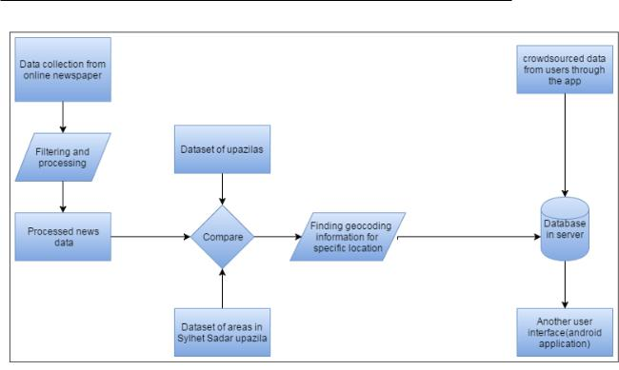
Figure: Basic System of our app

Slide 16
Methodology
In order to combine best prediction and best user experience, We mixed Feature Engineering with Machine Learning algorithms
Notes:
Try

Slide 17
Challenges in Data Collection
From previous works on this topic, data was collected mostly from individuals manually, so data shortage and scattered data
Like developed countries, Bangladesh police does not have digitalized detailed crime data
We got the vision of crime attributes by studying and understanding crime characteristics
Then we collected desired dataset

Slide 18
Features
Our dataset has the following features:
occurrenceyear
occurrencemonth
occurrenceday
occurrencedayofyear
occurrencedayofweek
occurrencehour
MCI(Crime_Type)
Division
Neighbourhood
Premisetype

Slide 19
Preprocessing
Feature dropping: Unimportant features like Latitude, Longitude, Reported date were dropped
Column factorization: Enumerated type or categorical variable
One Hot encoding: Transform categorical features to a column of binary vectors
Only the latest values were kept for better future crime prediction

Slide 20
Feature Enrichment
For user convenience and better understanding of the crime occurrences, Extra column was added by feature engineering process.

Slide 21
Brainstorming and Testing of features
Checking how the features work with Model
Understanding the Best Feature Selection
Three Columns Selected (Day of Week, Hour, Crime
Crime Occurrence is generated on a specific hour of a day
Adjust all the Count Values on Specific Position
Add a Column on the Existing Dataset
Take a Count of Each Unique Value Occurrence
Checking for each Unique Combination of them
Figure: Feature Enrichment

Slide 22
Applying methods
We used different types of algorithms to measure accuracy and analyze which approach makes the best output.
Random Forest Classifier Fit our dataset with highest accuracy

Slide 23
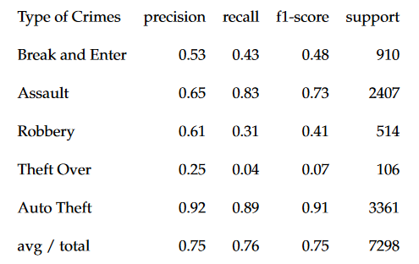
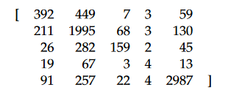
Random Forest Classifier
Before Encoding: Accuracy: 75.87 percent
Figure: Confusion Matrix
Figure: Classification Report

Slide 24
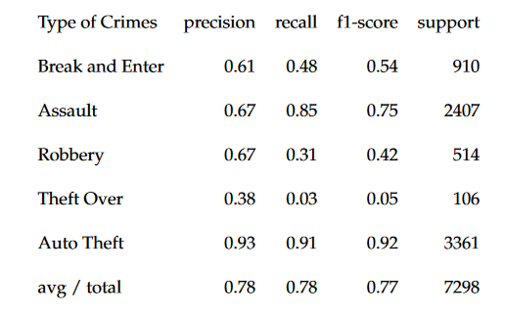
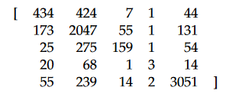
After Encoding: Accuracy: 78.02 percent
Figure: Confusion Matrix
Figure: Classification Report

Slide 25
Discussion
Encoding gives improved accuracy.
Because of its ensemble learning, Aggregation of individual predictions to make the best prediction and reduced error rate, it gives the best output for our dataset.
We tested result using different combinations of sklearn’s parameters –
n_estimators had to be more than 150
max_features could not be lower nor bigger; so we chose auto

Slide 26
Other Classifiers and Their corresponding Result:
Decision Tree:
Before Encoding: Accuracy: 70.35 percent
After Encoding: Accuracy: 72.46 percent
Linear SVM:
Before Encoding: Accuracy: 50.27 percent
After Encoding: Accuracy: 74.83 percent
Gradient Boosting Classifier:
Before Encoding: Accuracy: 68.65 percent

Slide 27
Occurrence Frequency Prediction
Its main purpose is to facilitate users with ease and accuracy
Users give input of a specific hour of a specific day
Total number of crime occurrence is showed
Most occurred crime is showed
Users can take necessary measures to solve the crimes

Slide 28
Future Work:
Criminal Profiling: Conclude certain attributes of criminals like name, hair-colour, eye-colour, nationality, blood group, age, marital status, whether member of any criminal groups etc.
Crime prediction and pattern generation will be more accurate if the dataset has features like: Criminal Organization, Name of victim/offender, categories and sub-categories of crime occurrence, type of vehicle offender used, type of weapons offender used.
Fully Automated system on the real time data collection process

Slide 29
Thank you

